Slide 1
MemPal – Memory App
T1A3
Xuan Lap (Leo) Tran

Slide 2
Topics
A walk-through of the terminal application, its features and how it is used.
Introduction
The problem it solves
A walk-through of the logic of the terminal application and code.
Walk-through of the Application - how to navigate the app
Key features: creating a new Memory Palace, viewing/editing a Memory Palace, and playing the mini game.
Code Walk-through
A review of the development/build process including challenges, ethical issues, favourite parts, etc.
Overview of the development process
Challenges, ethical issues, favourite parts

Slide 3
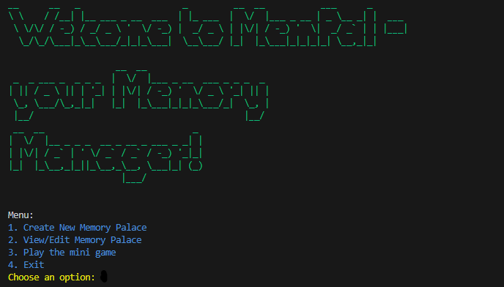
Introduction
MemPal is a terminal application that allows users to create and manage their own memory palaces.
A memory palace is a memory technique that involves associating information with specific locations in a familiar environment.
The problem is that for memory palace user, they don’t have a tool to store their memory palaces, and to test their memory palace with a simple game app. MemPal is the one to do just those 3 problems.

Slide 4
Walk-through of the Application
how to navigate the app
Key features: creating a new Memory Palace, viewing/editing a Memory Palace, and playing the mini game.
Code Walk-through

Slide 5
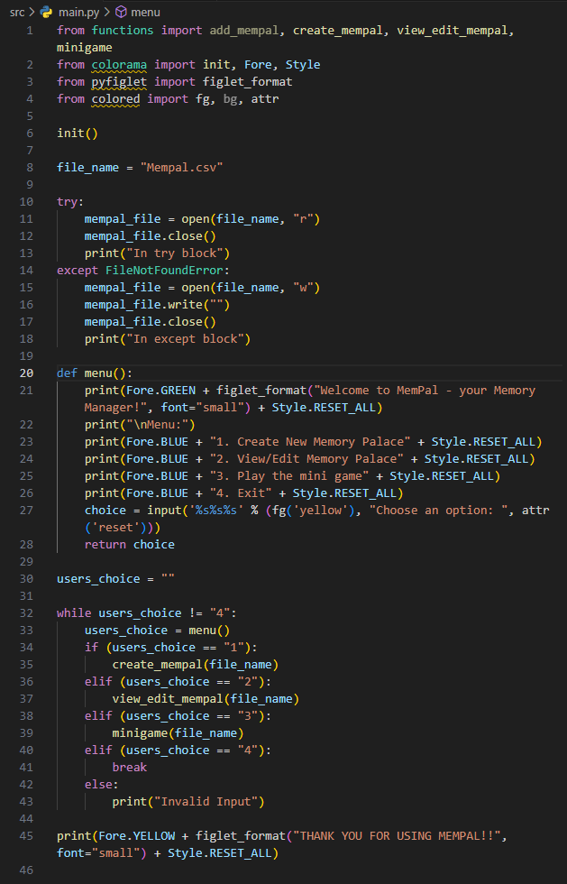

Slide 6
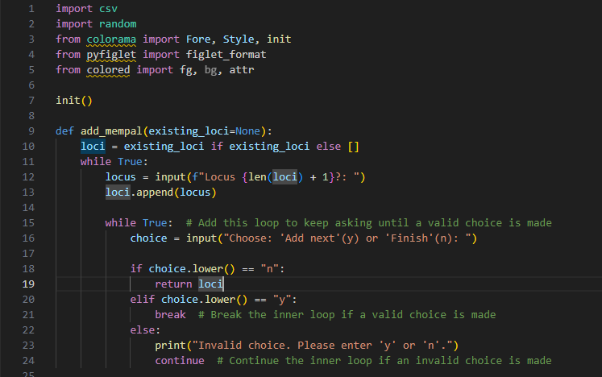
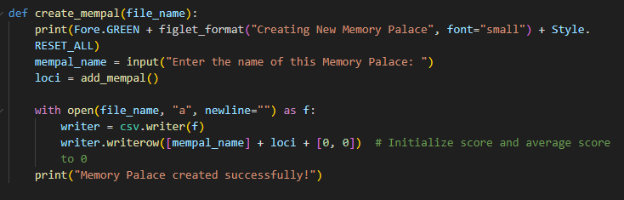
Add and ‘Create New’ function

Slide 7
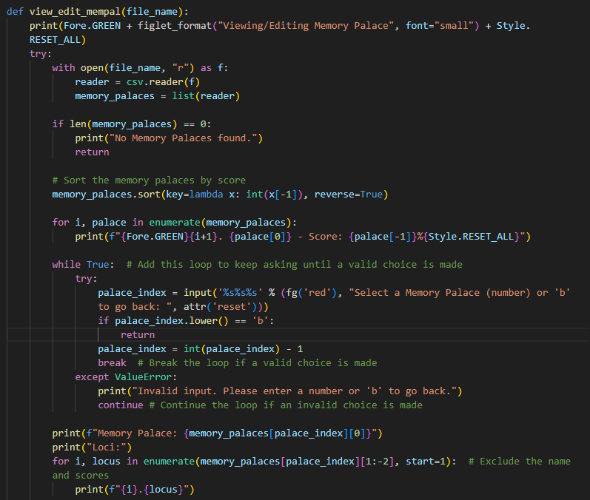
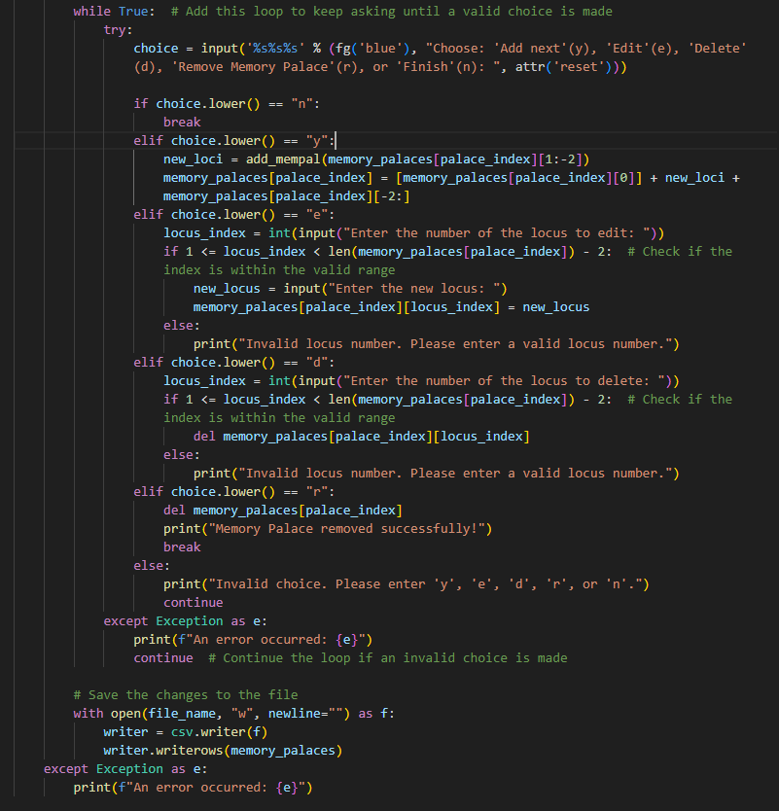
View and Edit Function

Slide 8
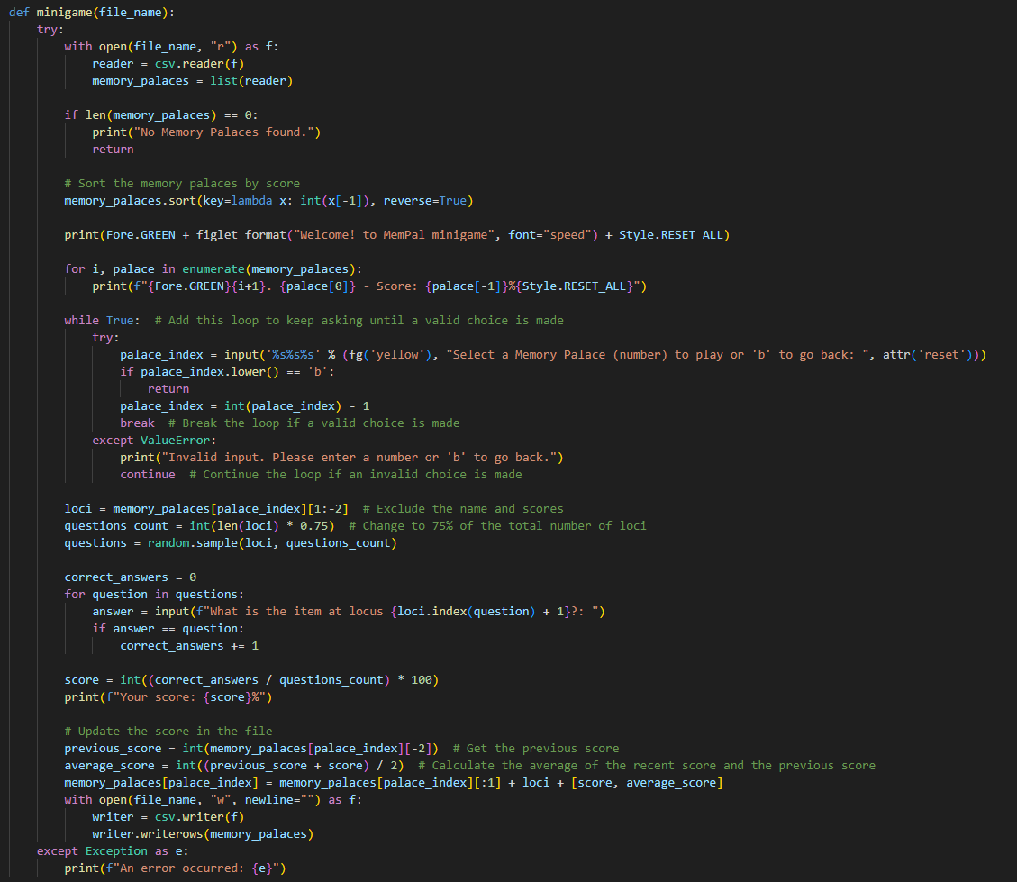
Minigame function

Slide 9
Overview of the development process
1. Start with the idea
2. Then the ideal features
3. Make use of Trello
4. Start coding
a. Folder/directory structure: follow the basic requirements of Docs, PPT and SRC.
b. Create a simple Readme file with simple framework to follow/update. And create a simple Implementation plan to follow/update.
c. Start coding with menu, file name
Testing
CODE REQUIREMENTS
- variables and variable scope
- loops and conditional control structures
- write and utilise simple functions
- error handling
- input and output
- importing a Python package
- using functions from a Python package
- Apply DRY (Don’t Repeat Yourself) coding principles

Slide 10
Challenges, ethical issues, and favorite parts
The hardest part is the testing: a lot of research/reading since the app has became complicated. Not just Pytest was used but also manual tests were done to speed up the process.
The most enjoying part is the idea/implementation plan, where you brainstorm what features could be in the app.
The favorite part is the coding itself, start small, from print menu to fixing function codes.
I am aware of and acknowledge the ethical principles that guide research and the use of ChatGPT. I understand that there are potential risks of plagiarism and privacy violation when using AI-generated code.
However, 90-95% of the codes have been done without the assistance from ChatGPT. ChatGPT was used for lambda sorting code, styling, explaining note for codes #, testing test 3, 1 out of for 4 tests, and most importantly csv sorting/indexing for score calculation as I was stuck with problems and issues.
All researches done through search engine and ChatGPT have been done carefully and purely for the purpose of obtaining deeper understanding, knowledge, skills and for assistance with understanding the problem and issue when hitting a road block.

Slide 11
That is the end of my presentation! I hope you enjoy, and Thank you for your time!

